Slide 1
DFRWS 2018 Challenge
Levi Portillo
Nate King Newton

Slide 2
Case Breakdown
The owner the illegal drug lab, Jessie Pinkman, is nowhere to be found. Police interrogate two of Jessie Pinkman’s known associates: D. Pandana and S. Varga. Pandana and Verga admit having access to the drug lab’s WiFi network but deny any involvement in the raid. They also say that Jessie Pinkman’s had the IoT security systems installed because he feared attacks from a rival gang and that Jessie kept the alarm engaged in “Home” mode whenever he was inside the drug lab.

Slide 3
Digital Crime Scene Reconstruction
While analyzing the files and evidence collected from the Crime Scene, We discovered several IoT devices. Not including the internet, we uncovered nine devices traced to our suspect Mr. Pinkman. These devices along with a network topology have been presented below

Slide 4
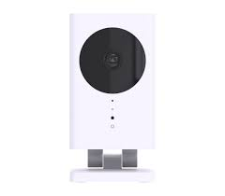
QBee Camera
Mac Address: d8: fb: 5e:e1:01:92
IP Address: 10.20.30.15
The QBee Camera is a multi-sensor device that allows you to watch your home on your phone. This camera boasts a 140-degree angle that detects motion, temperature, humidity, and level of brightness. Night vision is included, and it streams in 720p. All this information including the live stream can be acquired from your smartphone, and it will also alert you if anything is detected. This device will keep all recordings for seven days in an encrypted cloud storage.

Slide 5
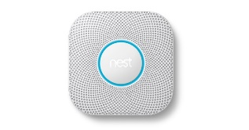
Nest Protect
Mac Address: 18:b4:30:99:9f:85
IP Address: 10.20.30.19
The Nest Protect is a next generation smoke detector. The device has two sensors which can detect smoke and other harmful gasses such as C0. The smoke detector test itself up to 400 times daily, and even performs a sound check on its speakers. To perform this sound check, the detector contains a small microphone. When something is wrong, it will alert your phone immediately.

Slide 6
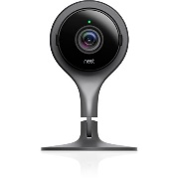
Nest Camera
Mac Address: 18:b4:30:61:c9: ef
IP Address: 10.20.30.13
This all in one doorbell, security system, pet cam, and thermostat can record up to 30 days of 24/7 video history with a subscription or 3 hours without one. It has cloud based streaming and will send alerts directly to your phone. This camera even has the functionality to build timelines of events.

Slide 7
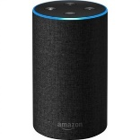
Amazon Echo
Mac Address: 74:75: 48:96:23:24
IP Address: 10.20.30.23
Amazon’s Echo has become a household device in millions of homes. This device started as a smart speaker but has evolved significantly. It contains multiple microphones that allow you to talk to the device and has a Wi-Fi connection to the amazon cloud. The echo records a snippet each time the awake word is activated. These are protected by encryption but are stored in the cloud. The device has compatibility with multiple devices.

Slide 8
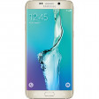
Samsung Galaxy s6 Edge
Mac Address: ac: 5f:3e:73:e3:78
IP Address: 10.20.30.21
This is an android smart phone. The device works like any other smart phone taking pictures and sending messages. It contains a lot of data that we can go through and analyze. A phone is one of the best devices to uncover in this investigation.

Slide 9
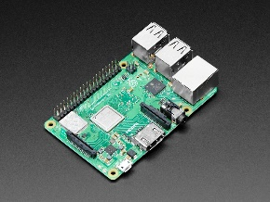
Raspberry Pi Router
Mac Address: b8:27: eb: 0e:3b:45
IP Address: 10.20.30.1
Raspberry Pi is the name of a series of single board computers. It was created for easier access to computing education. We can connect a mouse or several devices to this raspberry pi and work with programming languages

Slide 10
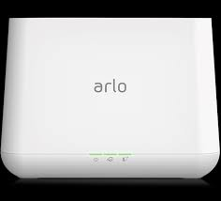
Arlo Pro Station
Mac Address: 08:02:8e: ff: 75:4f
IP Address: 10.20.30.17
Arlo Pro is a 100% Wire-Free indoor/outdoor home monitoring system. The Pro includes rechargeable batteries, motion and sound-activated alerts, 2-way audio, a 100+ decibel siren, and 7 days of free cloud HD video recordings. It also records a location once there is a motion. Arlo covers every angle to help keep you safe and protected.

Slide 11
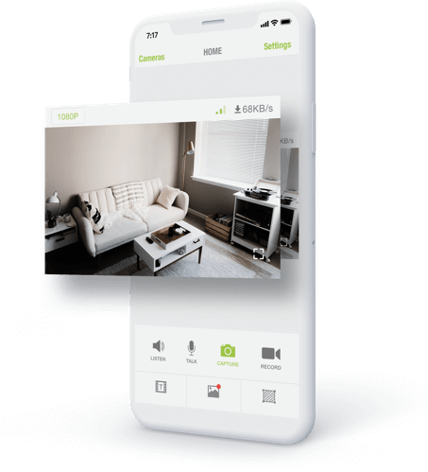
iSmartAlarm
Mac Address: 52:46:15:06:66
IP Address: N/A
The iSmartAlarm is a DIY security device that connects and is controlled by a user’s smartphone. It contains an activity log with user permissions. This device is also compatible with Amazon Echo. It has a HD camera and Smart switch as well as a Motion detector and door or window sensor

Slide 12
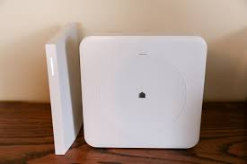
Wink Hub
Mac Address: b4:79:a7:25:02: fa
IP Address: 10.20.30.22
The Wink Hub is a device that connects multiple smart devices under one device. It is compatible with Amazon. Android, and more. The Wi-Fi required device is used for controlling door locks, motion sensors, and light sensors.

Slide 13
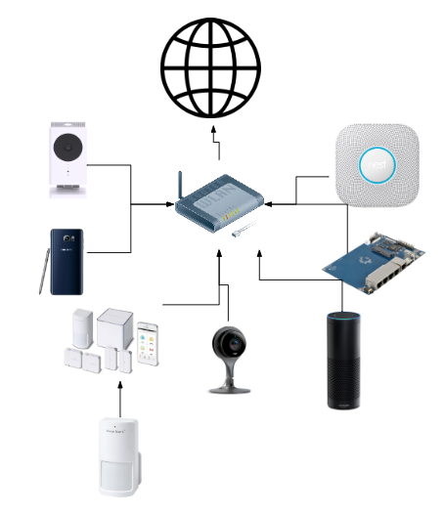
Network Topology

Slide 14
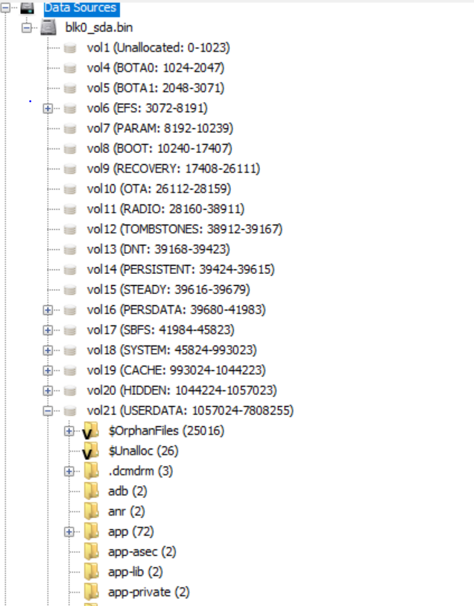
Analysis of Evidence of the Samsung
Physical extraction of Jessie Pinkman’s Samsung phone
We were given evidence which contained data for a Samsung Phone which is believed to be Jesse Pinkman’s phone. We downloaded this file, and upon unzipping it, opened it in the tool autopsy. Autopsy is a digital forensics tool which displays the results of a file in a GUI. In autopsy, the physical volumes of the device are shown below. The volume most relevant to this case is volume 21 which contains user data like images, videos, logs, and more. This is the most relevant and useful file for the case.

Slide 15
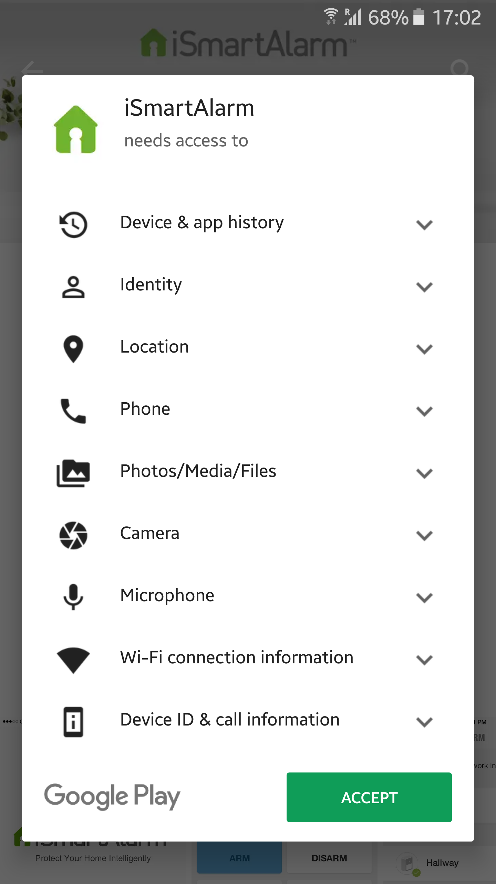
Samsung

Slide 16
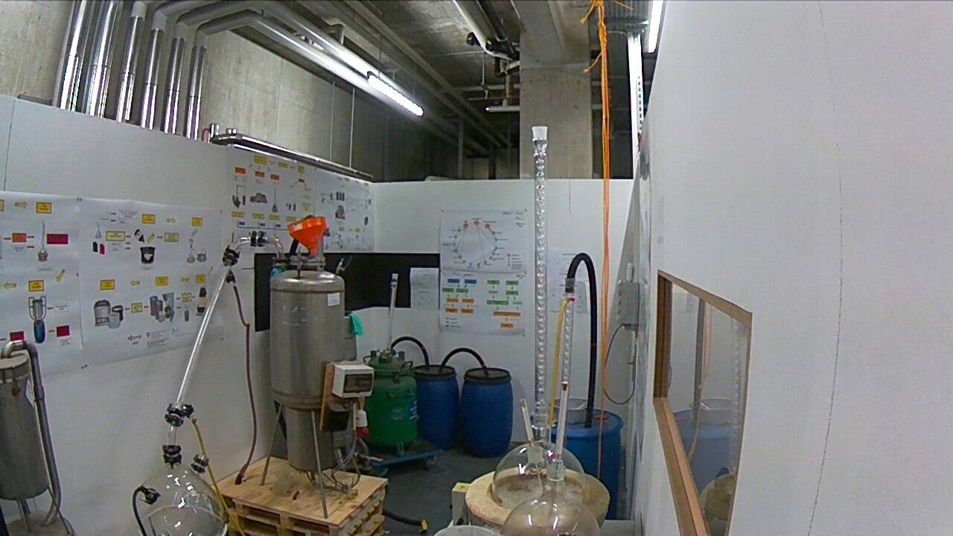
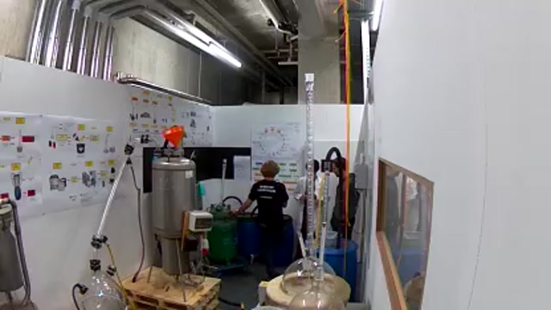
NEST

Slide 17
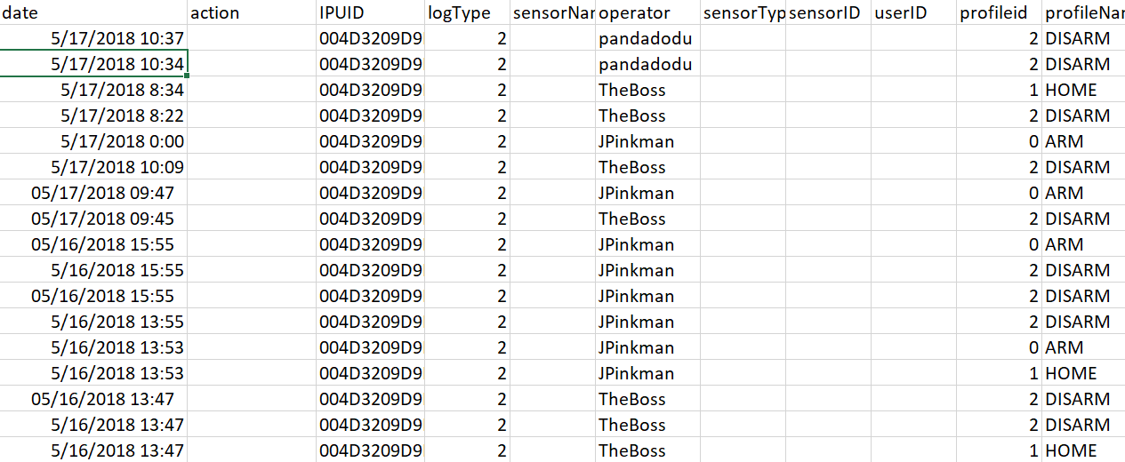
iSmartAlarm

Slide 18
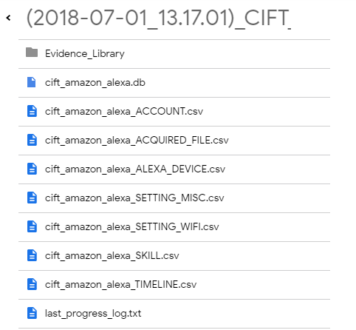
Eco

Slide 19
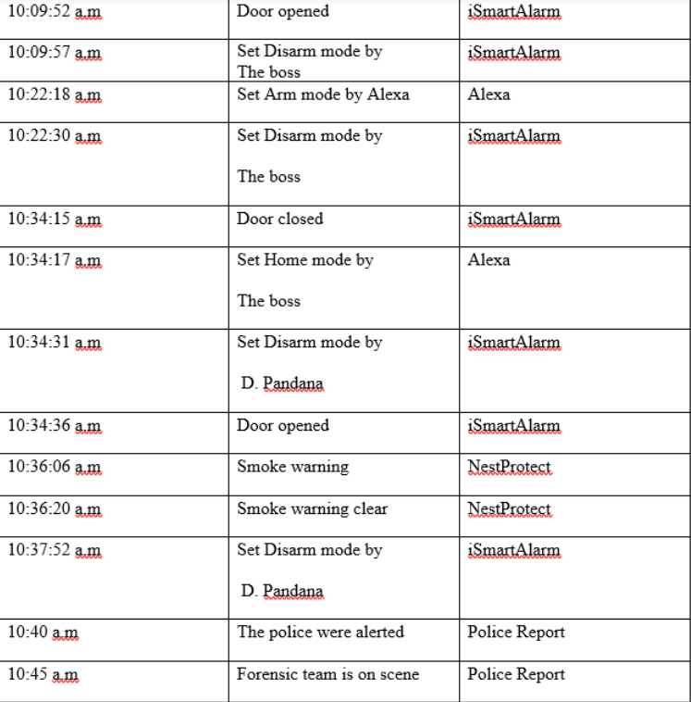
Time Line

Slide 20
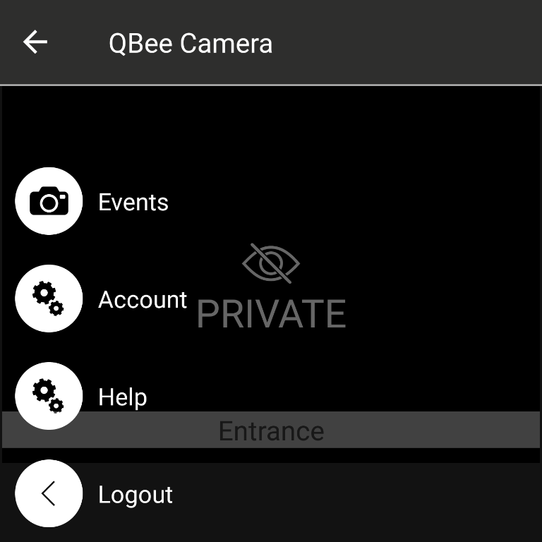
Qbee Camera

Slide 21
Attorney’s questions
At what time was the illegal drug lab raided?
We can conclude from our findings, that the lab was raided around 10:36 am. The nest smoke alarm is triggered at 10:36:06 a.m.
Could any of the two friends of Jessie Pinkman have been involved in the raid?
Yes
If yes, Which friend? There is one friend in particular named D. Pandana that was involved in the raid. This suspect disarmed the iSmartAlarm at 10:34 which is two minutes before the nest protect smoke alarm. This leads us to the conclusion that he was the one that committed the raid.
What is the confidence in such hypothesis? The confidence in this judgement is certain. His tag was used to disable the iSmartAlarm minutes before the crime was committed.
How was the QBee camera disabled?
In a picture that was found on the smartphone, we were able to see that the QBee camera was set to private. In private mode, no video is recorded which is why no video evidence was taken from the scene.

